Slide 1

GUVI
crafting & compelling website analysis
Audit and Recommendations.
BY S.ANITHA

Slide 2

1.COMPANY SELECTION :-
https://wiproconsumercare.com/brands-india/

Slide 3

INTRODUCTION
wipro
Western India Vegetable Products
Founded by
wipro Limited
M. H. Premji
Mohamed premji
Multinational corporation,technology,business process services
Headquartered
Employs
Bangalore
250,000

Slide 4
Wipro operates across various industries, including:
Banking
Banking operations, financial transactions, compliance.
Healthcare
Healthcare IT, patient care, medical research
Customer experience, supply chain management, digital transformation.
Retail
Manufacturing processes, supply chain management, production efficiency
Manufacturing
Network management, customer experience, digital transformation
Ccomunication
Energy management, smart grids, environmental compliance
Energy

Slide 5
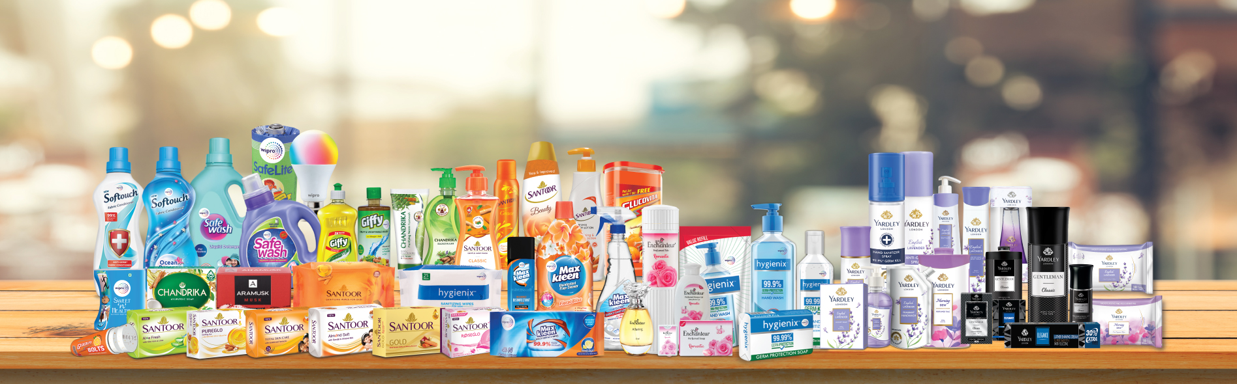
2.PRODUCT DESCRIPTIONS

Slide 6
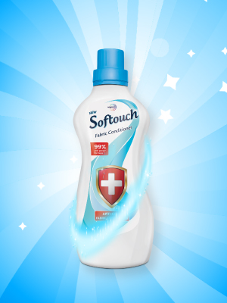

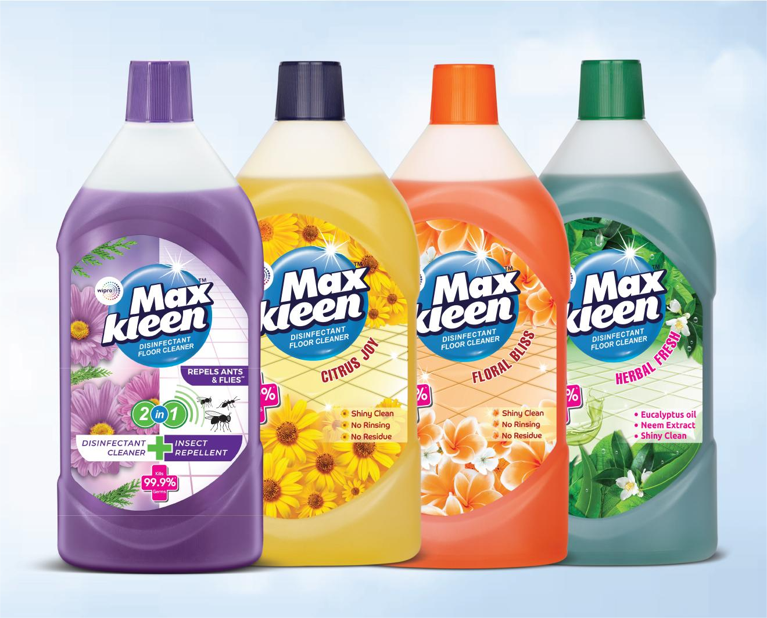
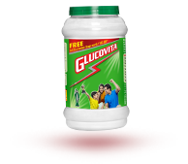
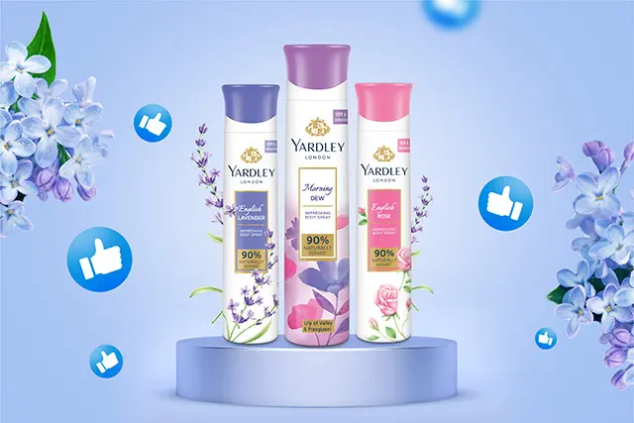
Softouch
Chandrika Ayurvedic Soap
MAX KLEEN
GLUCOVITA
YARDLEY
Notes:
Enter title

Slide 7
Softouch Anti Germ
Wipro’s Softouch is India’s first fabric conditioner with
German Encapsulation Technology
99% germ protection
Clean, hygienic, soft clothes
Refreshing fragrance
Active conditioning agents to work even in hard water

Slide 8
Chandrika Ayurvedic Soap
Chandrika is the world’s first Ayurvedic Soap,
with a legacy of over 75 years
Good for acne, dark spots & dry skin
With 2x coconut oil
Natural Ayurvedic ingredients
Handmade

Slide 9
MAX KLEEN
Max Clean is a line of cleaning products that offers a range of solutions for various cleaning needs. Here are some key points about Max Clean products:
Convenient and easy cleaning
Sparkling cleanliness
Fresh and clean scent
Gentle on hands and surfaces
Cost-effective

Slide 10
GLUCOVITA
Glucovita is a popular Indian brand of glucose powder, which is a common
dietary supplement. Here are some key points about Glucovita
Provides instant energy
Helps to replenish energy stores
Supports physical performance and endurance
Can help to manage hunger and support weight gain
Suitable for individuals with busy lifestyles, athletes, and students

Slide 11
YARDLEY
Yardley is a British personal care brand that offers a range
of products.
Yardley products are known for their gentle, moisturizing properties
Many products feature natural ingredients like lavender, chamomile, and rose
Soaps are often made with traditional techniques and recipes
Fragrances are designed to be subtle and long-lasting

Slide 12
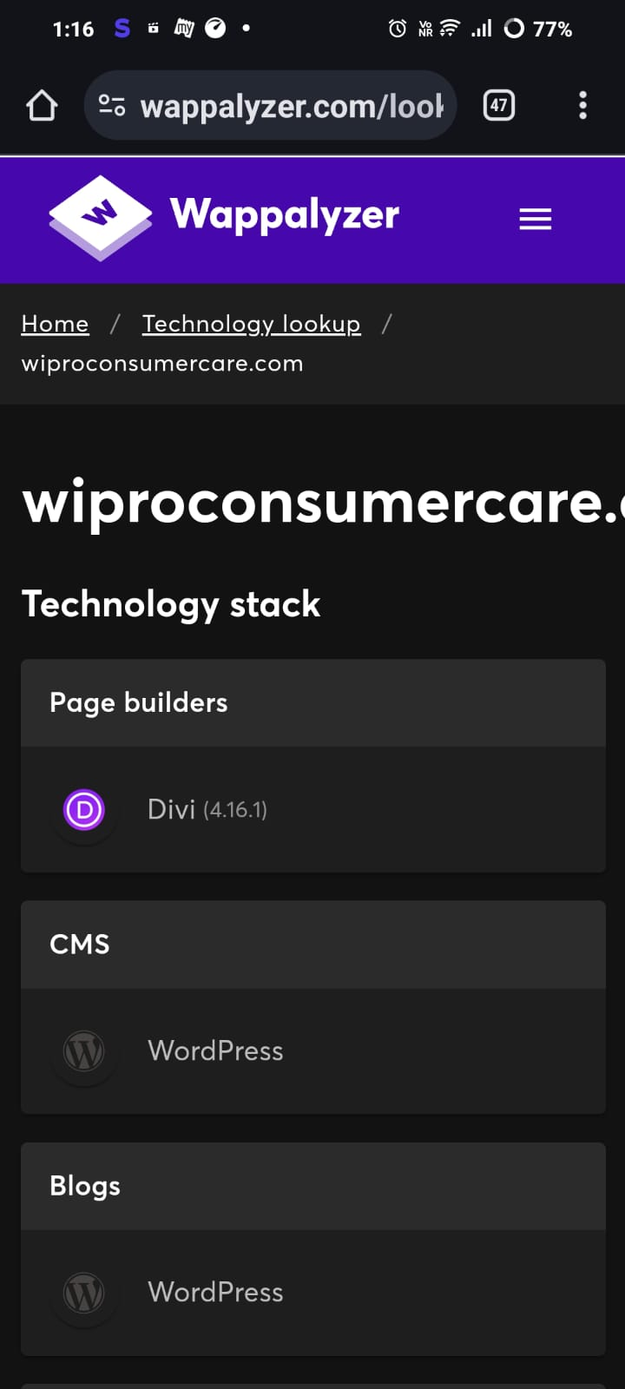
3.WEBSITE PLATFORM IDENTIFICATION
USE TO TOOLS

Slide 13
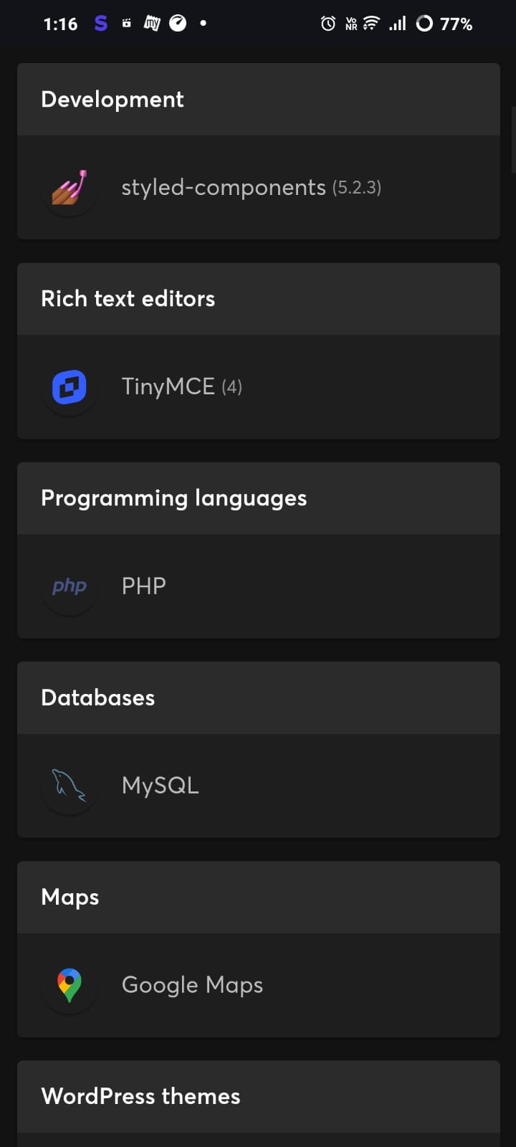
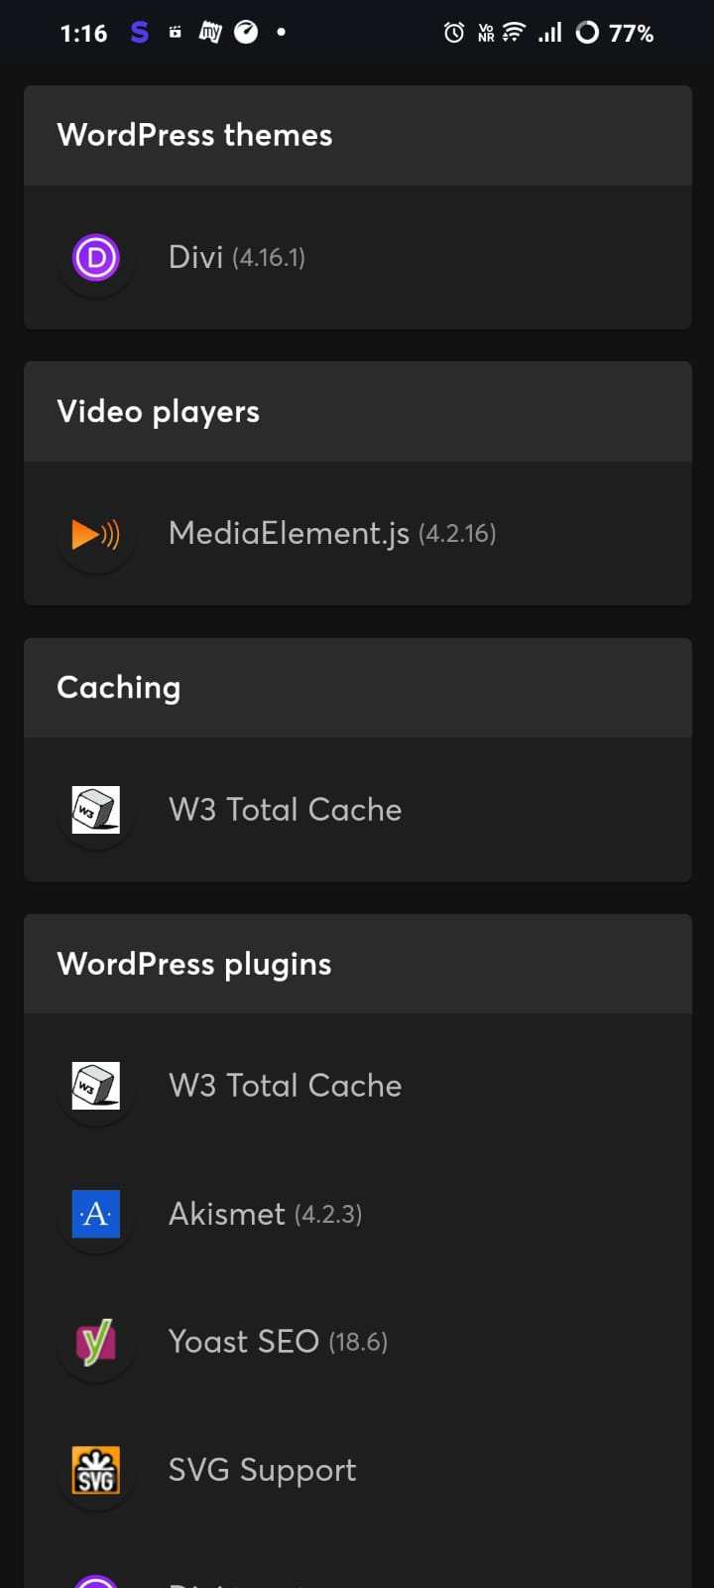

Slide 14
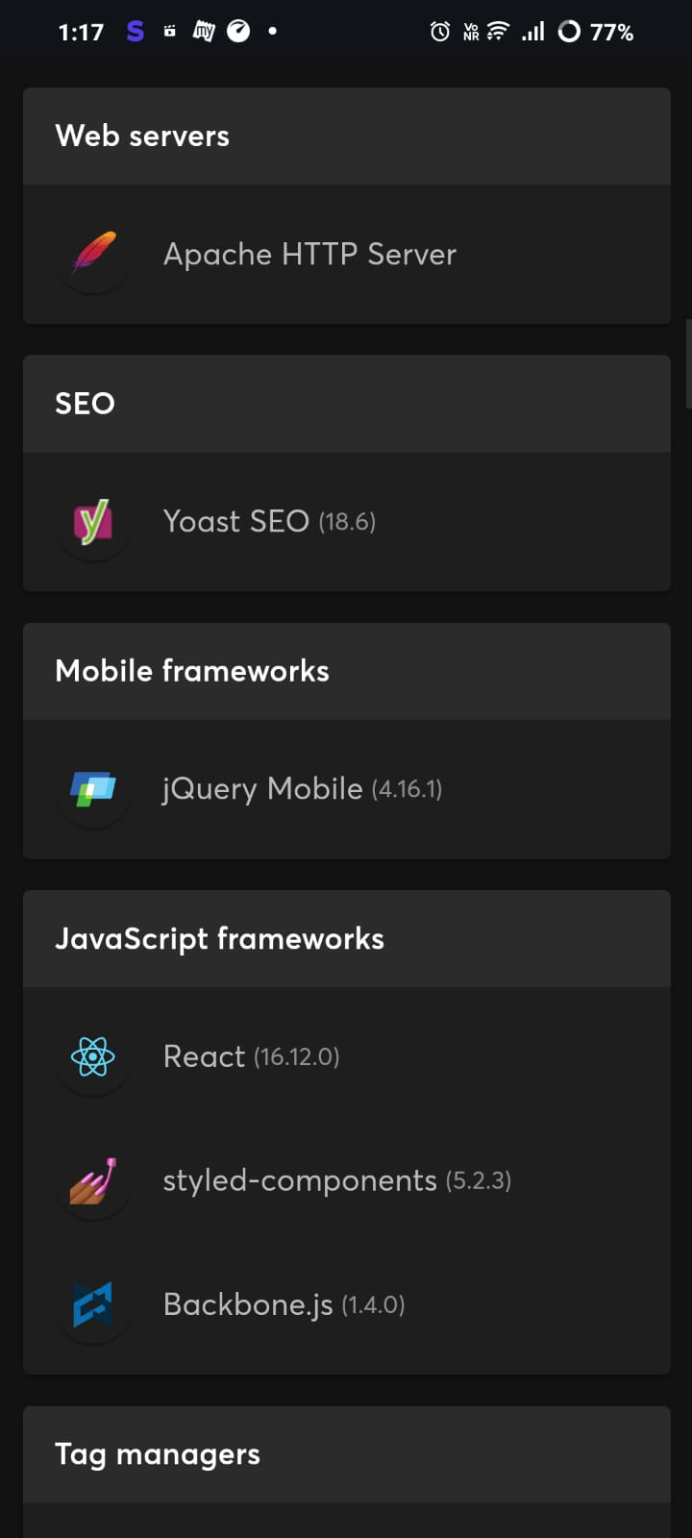
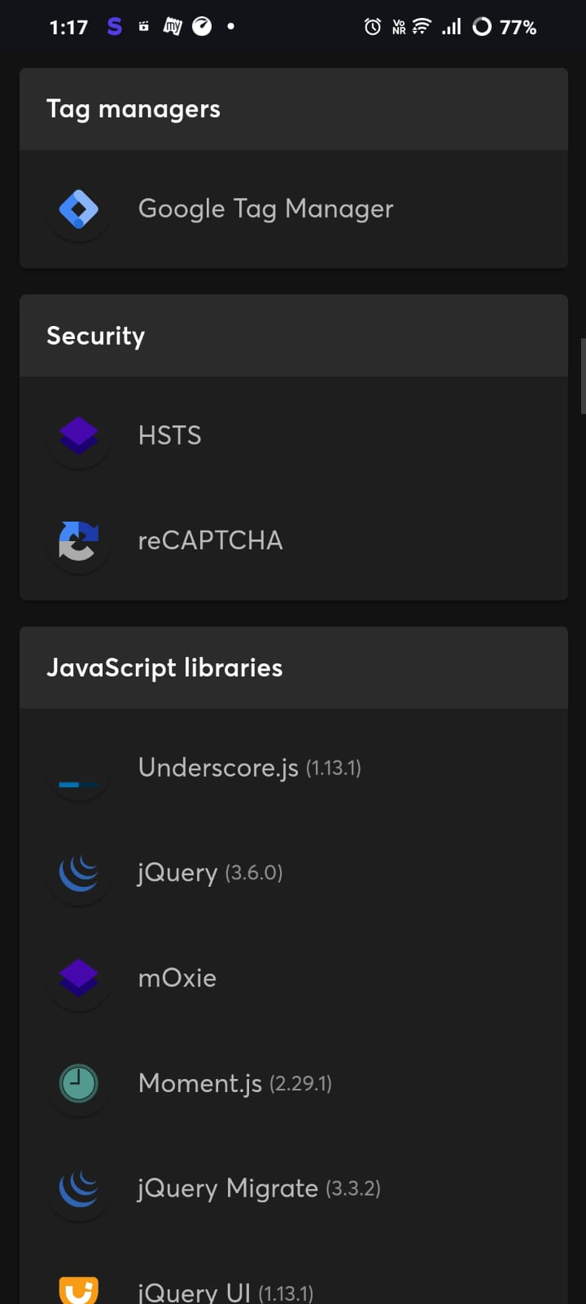
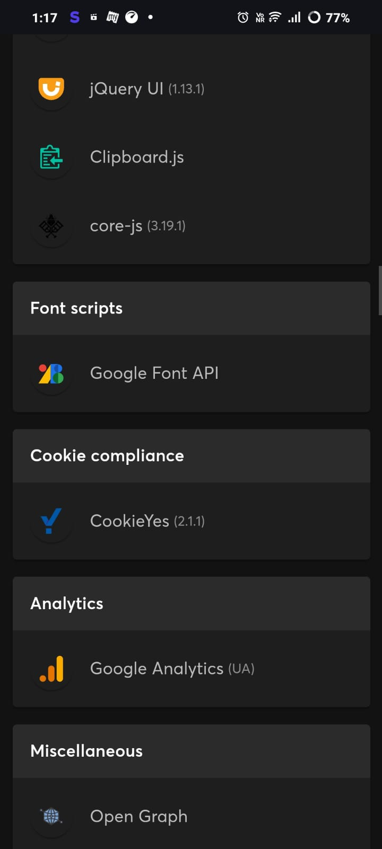

Slide 15
4.RESPONSIVE DESIGN TESTING
https://wiproconsumercare.com/brands-india/
Softouch Anti Germ
https://wiproconsumercare.com/softouch-anti-germ/ CLICK HERE
2. Chandrika Ayurvedic Soap
https://wiproconsumercare.com/chandrika-ayurvedic-soap/ CLICK HERE

Slide 16
3. MAX KLEEN
https://wiproconsumercare.com/maxkleen-disinfectant-floor-cleaner-2/ CLICK HERE
4. GLUCOVITA
https://www.glucovita.com/ CLICK HERE
5.YARDLEY
https://www.yardleyoflondon.com/ CLICK HERE

Slide 17
5.WEBSITE MISTAKES IDENTIFICATION
Reduce server response times :
The Opportunities section of your Lighthouse report reports server response time—the time that it takes for a user's browser to receive the first byte of page content, after making the request.
Remove unused CSS :
The Opportunities section of your Lighthouse report lists all stylesheets with unused CSS with a potential savings of 2 KiB or more. Remove the unused CSS to reduce unnecessary bytes consumed by network activity
Remove unused JavaScript :
If the JavaScript is render-blocking, the browser must download, parse, compile, and evaluate the script before it can proceed with all of the other work that's needed for rendering the page.

Slide 18
Optimize Cumulative Layout Shift :
Unlike the other Core Web Vitals, which are time-based values measured in seconds or milliseconds, the CLS score is a unitless value based on a calculation of how much content is shifting and by how far.
In this guide, we'll cover optimizing common causes of layout shifts.
The most common causes of a poor CLS are:
Images without dimensions.
Ads, embeds, and iframes without dimensions.
Dynamically injected content such as ads, embeds, and iframes without dimensions.
Web fonts.
Efficiently encode images
The Opportunities section of your Lighthouse report lists all unoptimized images, with potential savings in kibibytes (KiB). Optimize these images so that the page loads faster and consumes less data

Slide 19






6.BEST PRACTICES LIST:
1.Define Objectives and Requirements
2. Development
- Choose suitable platform (CMS like WordPress or custom-built solution)
- Code website using HTML, CSS, JavaScript, and other technologies
- Implement functionalities (forms, search, interactive elements)
Identify primary goals (informational, customer engagement, service offering
3. Design
- Develop visual design aligned with Wipro's branding and identity
- Create mockups and prototypes for review and feedback
5. Research and Planning
Wipro Best practicex list
Study Wipro's brand guidelines, digital presence, and competitors
Create sitemap and wireframes for site structure and layout
4. Content Creation
- Prepare and organize content (text, images, videos, media)
- Ensure content is relevant, engaging, and SEO-optimized

Slide 20
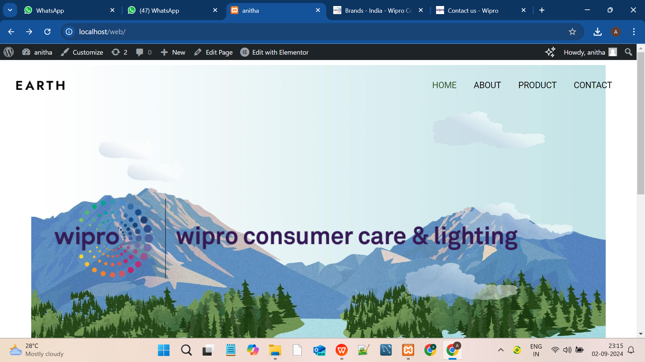
7.WEBSITE DESIGN:

Slide 21
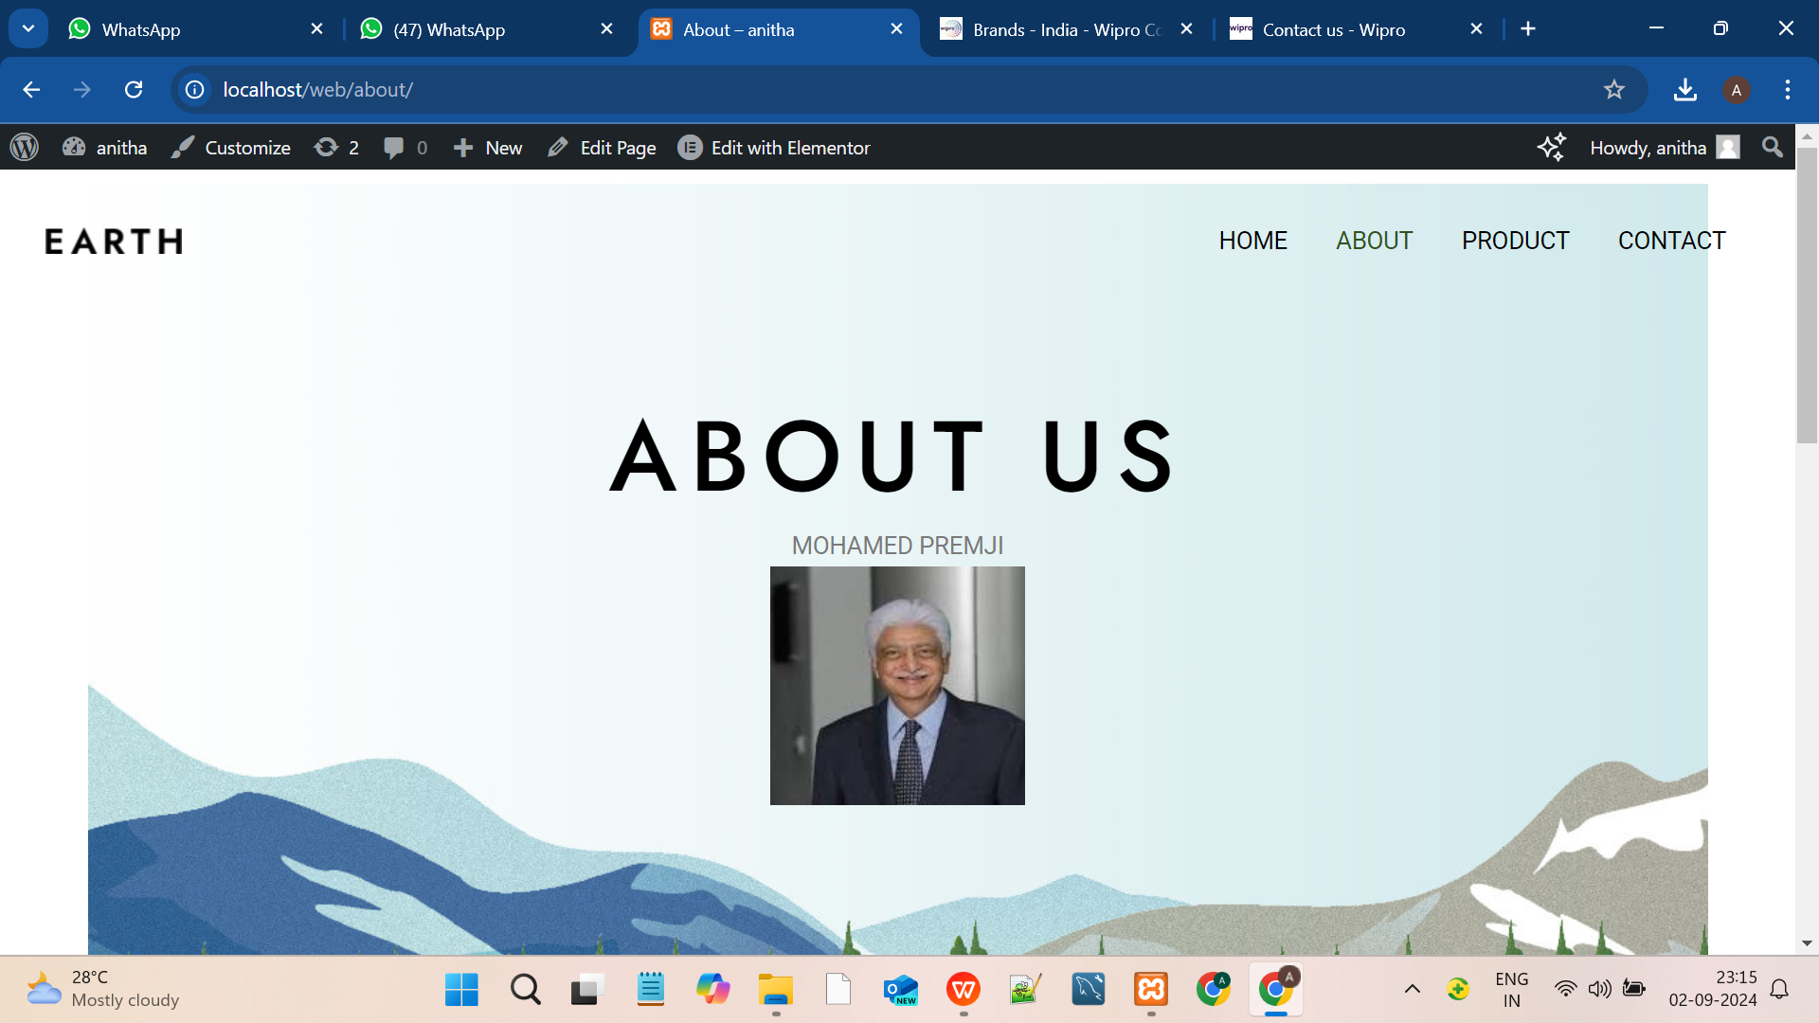

Slide 22
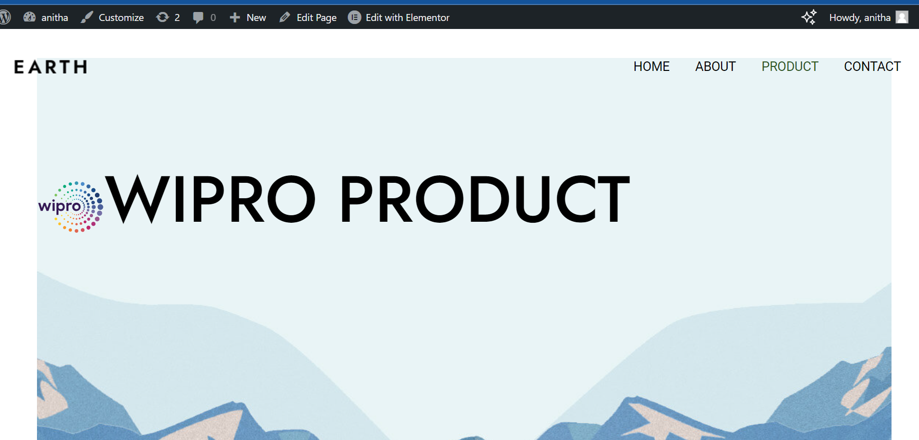

Slide 23
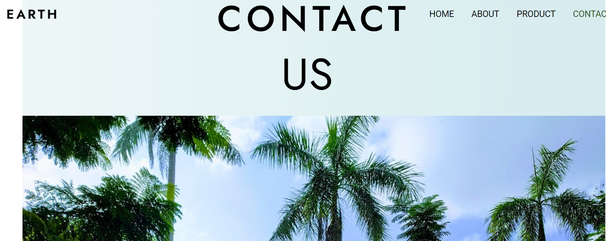

Slide 24
Thanks

